Slide 1
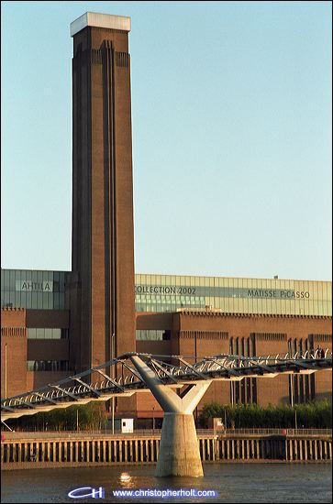
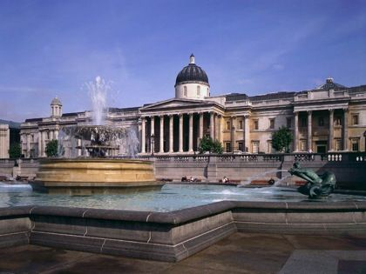
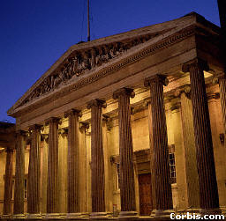


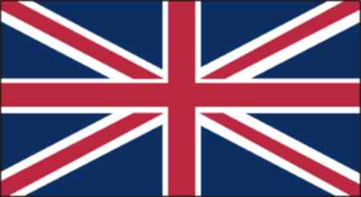
London's museums
Tate Modern
British Museum
London
Madame Tussauds
HOME
Notes:
<number>

Slide 2
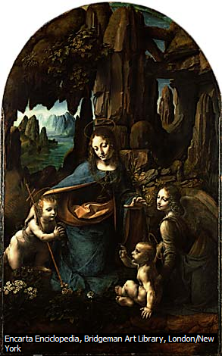
Founded 1824, this is a national treasure. From a mere 38 paintings at the start, the collection has grown into one of the greatest in the word, with more than 2,000 classic Western European paintings. There are masterpieces from virtually every school of art, starting with 13th century religious works and culminating in Van Gogh . You name it, they’re here: Leonardo da Vinci, Raphael, Titian, Rubens, Rembrandt, Van Dyck, Caravaggio, Turner, Monet, Constable, Gainsboroungh, Cézanne and Picasso. You can’t see everything in one visit ,but there are guided tours that take in major works. The free audio guides offer excellent tours of th art. The Sainsbury Wing concentrates on the early Renaissance period, with an emphasis on Italian an Dutch painters. In the North Wing, look out for Vermeer and Dutch paintings. The East Wing has a strong collection of English Paintings, include Constable’s masterpieces, Turner’s romantic watercolours and works by Gainsborough, Reynolds and Hogarth. The real big-ticket items, however, are the Impressionist paintings: Monet’s Water Lilies series, Van Gogh’s Chair and Seurat’s Bathers at Asnières are the stars.
Leonardo
National Gallery
London's museums

Slide 3
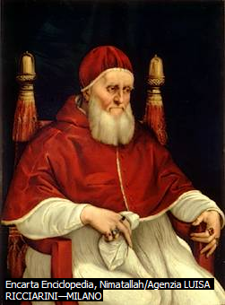
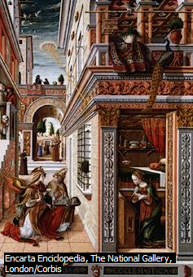
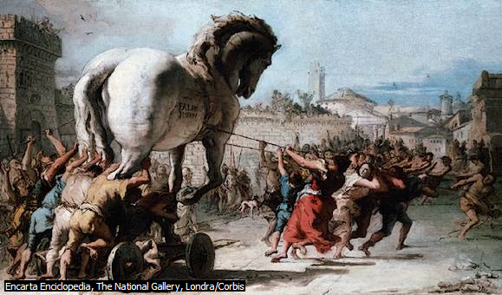
Crivelli
Raffaello
Tiepolo

Slide 4
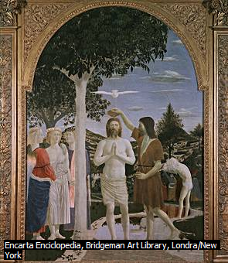
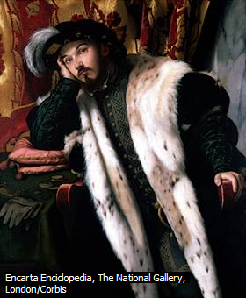
Moretto da Brescia
Piero della Francesca

Slide 5
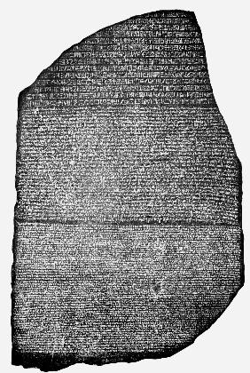
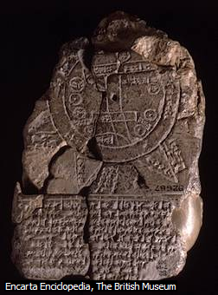
British Museum
London's museums
The British Museum is one of the most popular tourist attractions. The museum building is a neoclassical marvel built in 1847 by Robert Smirke.
The Norman Foster’s glass-roofed great court is the largest covered space in Europe. It opened in 2000, this surrounds the domed Reading Room, where Marx, Lenin, Dickens, Hardy, Yeats and Thackeray once worked.
The highlights of the Museum include the Rosetta Stone, statues of the pharaohs, mummies and Greek antiquities, such as the marble statues and details from the Parthenon. The Celts gallery has Lindow Man, killed in 300BC and preserved in peat. In 2003 the Welcome Gallery of Ethnography opened with an Easter Island statue and regalia from captain Cook’s travels. Don’t try to see everything in one day; instead, buy a souvenir guide (£6), and pick out the showstoppers.

Slide 6
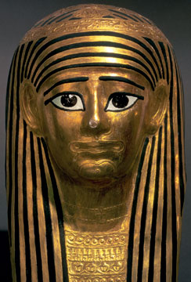
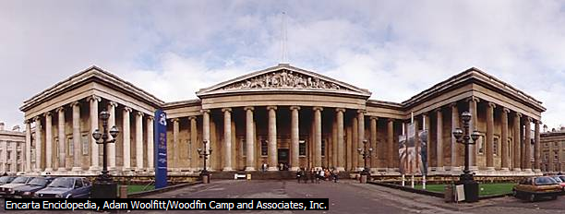
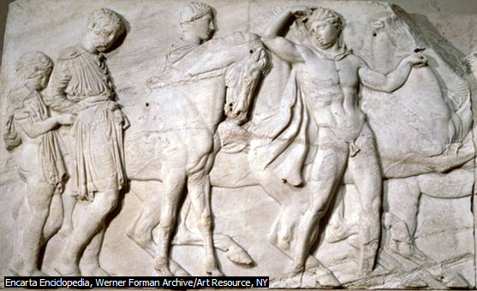
British Museum
British Museum

Slide 7
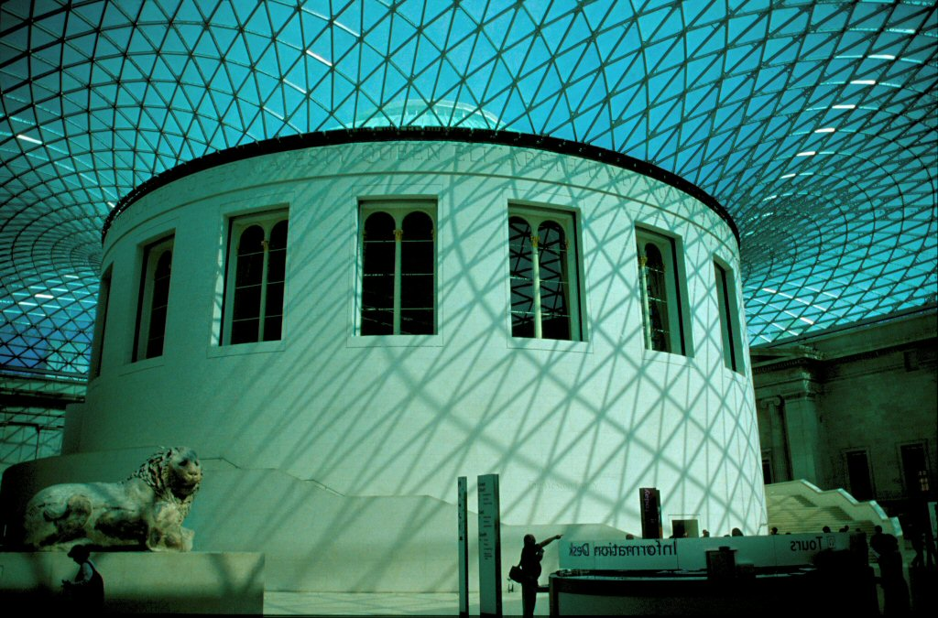

Slide 8
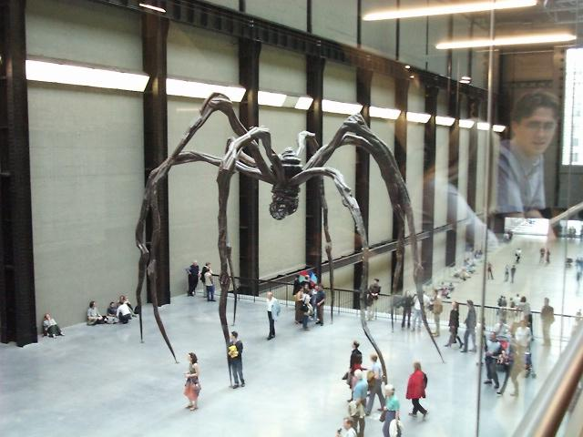
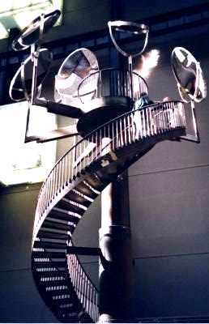
The Tate Modern
London's museums
The Tate Modern is in a former powerhouse.
The Tate Modern is on the South bank of the River Thames near the Globe Theatre,opposite St Paul’s Cathedral and the City of London.
The Tate Modern’s scale is awe-inspiring even before you tour the collection, moved in 2000 from the original Tate, now called Tate Britain.
The vast Turbine Hall space is always used for the display of large-scale works.

Slide 9
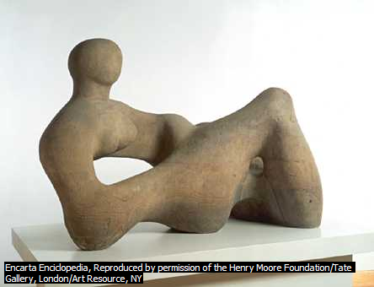
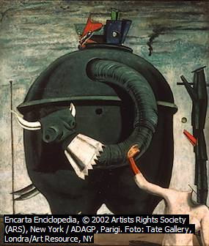

Moore
Ernst
Rosso

Slide 10
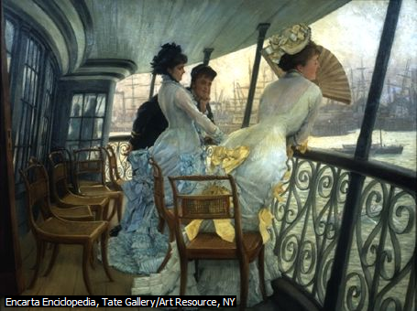
The building is striking and distinguished. It was designed by the architect Sir Giles Gilbert Scott. It offered all the space that was required for this huge collection of contemporary art. The boiler house became the galleries. These are on three levels running the full length of the building. The Tate collection of modern art is displayed on two of the gallery floors, the third is devoted to temporary exhibitions.
Above the original roof of the power station architects Herzog and De Meuron added a two-storey glass penthouse, known as the lightbeam. The chimney was capped by a coloured light feature designed by the artist Michael Craig-Martin, known as the Swiss Light.
At night, the penthouse lightbeam and the Swiss Light mark the presence of Tate Modern for many miles.
The Tate Modern

Slide 11
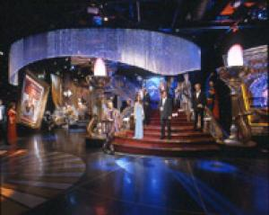
Madame Tussauds
It is very popular museum in the centre of London. It has a large collection of wax sculptures of famous people.
Today Madame Tussauds holds a large collection of famous figures from around the word. It also has a “spirit of London” ride that takes thought the sights and sound of London including the infamous Jack the Ripper.
London's museums

Slide 12
History
Curtains taught Tussauds the art of wax was shown in 1770.He opened a second location on boulevard du temple. One of main attractions of her museum was the chamber of horrors.
This part of the exhibition included some victims of the “French Revolution” and also newly created figures of murderers and other criminals. Other famous people were added to the exhibition.
Some sculptures done by Tussauds herself still exit. The museum moved to its current location on Mary Leborne Road in 1884. In 1925 a fire destroyed many of figures, but the holds survived allowing the historical waxworks to be remade. Has now grown to become a major tourist attraction in London.
Rooms
Has expanded with branches in Amsterdam, Hong Kong, Las Vegas and New York City.
Madame Tussauds invites you to an unique experience.
There are nine rooms: BB Diary Room, Air Guitar stars, Jose’s Dream Team, Blush, Auditorium, Chamber Live, Word Stage, Premiere Night and Spirit of London. Jose’s Dream Team: this section of the museum shows a collection of great football player from a section of international team. Air Guitar star: this section of the museum shows a collection of statues of rock stars.
Blush: this section of the museum shows a collection of statues of a celebrity. Auditorium: this selection of the museum shows statues in full color and digital technology. Chamber Live: this section of the museum shows of statues of serial killers. World Stage: this section of the museum shows of statues of political leaders, Premiere Night:it is a slavish production with a dazzling cast of Oscar-winning actors from 1914 to the present day. Spirit of London:in this section you’ll witness the achievements of the greatest Londoners of all-time, from Shakespeare to the swingers in the 60s.

Slide 13

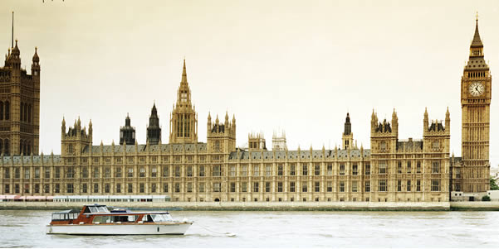
Westminster Palace and Big Ben
London
HOME

Slide 14
Westminster Palace and Big Ben
Visitors may see the House of Commons and the House of Lords and listen to debates from the Strangers’ Gallery.
First, you must join the public queue outside St Stephen’s Entrance. Queue for admission Monday to Thursday after 16.15 and on Friday after 11.30.
Admission is free. The Palace of Westminster was the principal residence of the kings of England from the middle of the 11th century until 1512. In medieval times kings summoned their courts wherever they happened to be. But by the end of the 14th century the court in all its aspects - administrative, judicial and parliamentary - had its headquarters at Westminster.
Although the Lords were accommodated in the Palace, the Commons originally had no permanent meeting place of their own, meeting either in the chapter house or the refectory of Westminster Abbey. After the Chantries Act 1547 abolished all private chapels, the Royal Chapel of St Stephen within the Palace of Westminster was handed over to the Commons.
The Commons assembled in St Stephen's until 1834 when the Palace was burned down. This fire destroyed almost all of the Palace except Westminster Hall, the crypt of St Stephen's Chapel, the adjacent cloisters and the Jewel Tower.
The present Houses of Parliament were built over the next 30 years. They were the work of the architect Sir Charles Barry (1795-1860) and his assistant Augustus Welby Pugin (1812-52). The design incorporated Westminster Hall and the remains of St Stephen's Chapel.
The House of Commons Chamber was destroyed in a German air attack in 1941. It was rebuilt after the Second World War, taking care to preserve the essential features of Barry's building - the architect was Sir Giles Gilbert Scott. The new Chamber was completed in 1950.

Slide 15


Home
Home
Big Ben
London
The Palace of Wesminster is the home of the British Parliament which is formed by The House of Lords and the House of Commons.
When the Palace of Westminster was destroyed by fire in 1834, the task of reconstructing the building was given to the architect Charles Barry.
A clock tower was part of the final project.
The clock had to be the finest ever made.
The clock is very big and has a pendulum which is 3.9 metres long.
Attached to the pendulum is a small platform on which there are a few weights including some pennies.
The big bell, which is famous all over the world as Big Ben, strikes the hours.
Unfortunately, the giant bell cracked in 1857 and a new one was made in 1858.
We do not know exactly why these giant bell is called Big Ben.
In 1859, the giant bell cracked again and for the next three years Big Ben was silent.
Then the bell was repaired and in 1862 the voice of Big Ben again boomed out over London.
It is the very same voice which can be heard today.

Slide 16
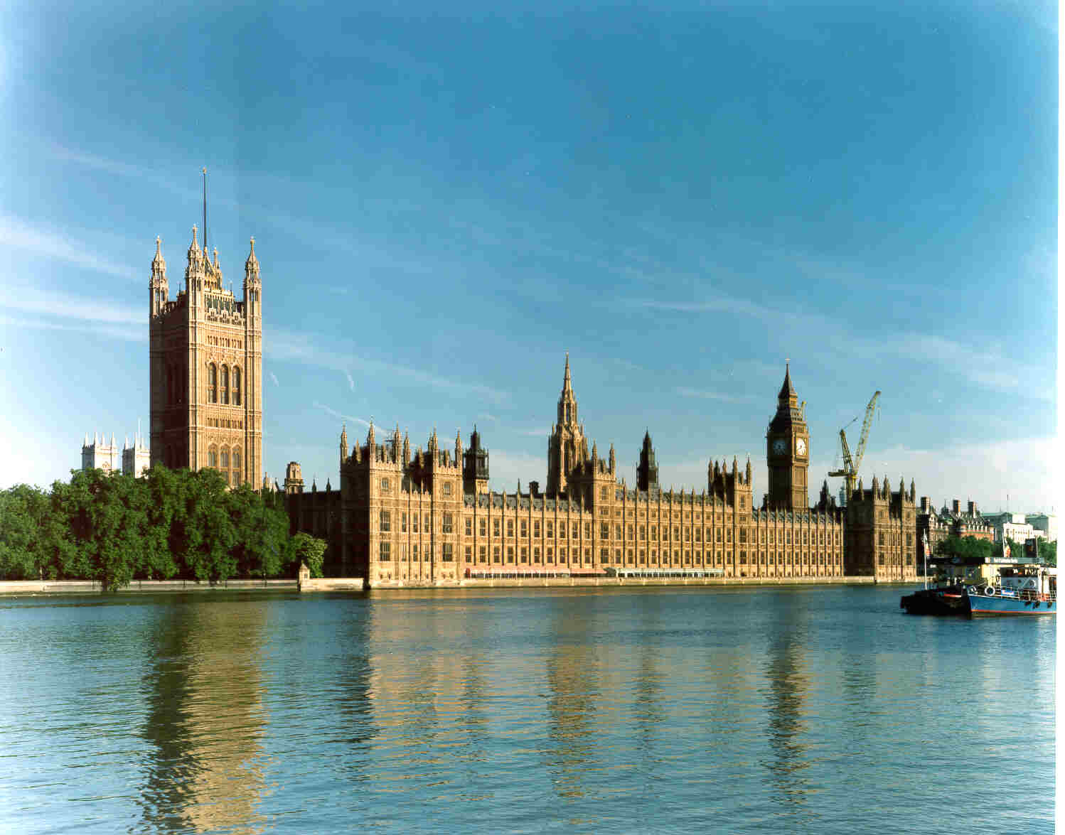
Westminster Palace

Slide 17
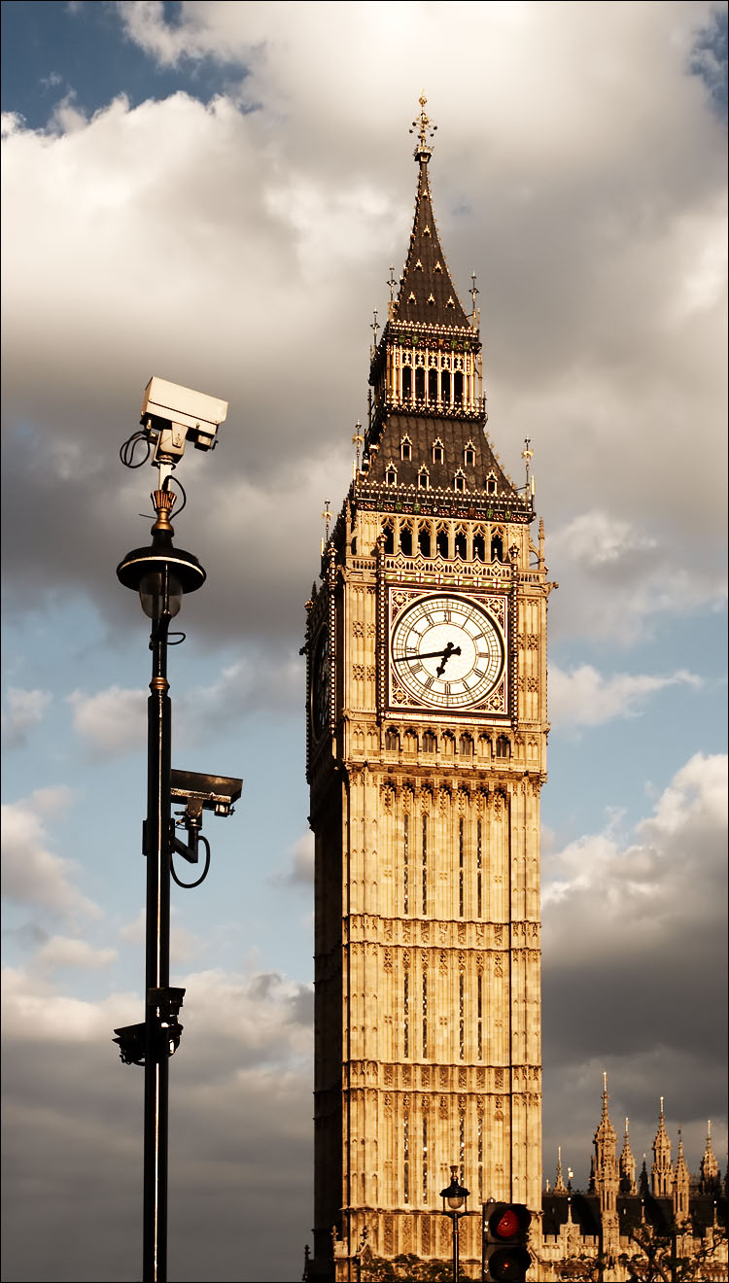
The Big Ben

Slide 18
shopping and places
Covent Garden Trafalgar Square
Leicester square
Piccadilly Circus
Shopping

Slide 19

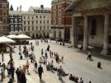
Covent Garden
Covent Garden is a district in central London and within the easterly bounds of the City of Westminster. The area is dominated by shopping and entertainment facilities and contains an entrance to the Royal Opera House Covent Garden, which is also widely known simply as "Covent Garden," and the bustling Seven Dials area. The area is bounded by High Holborn, Kingsway, The Strand and Charing Cross Road. Covent Garden Piazza is located in the geographical centre of the area and was the site of a flower, fruit and vegetable market from the 1500s until 1974, when the wholesale market relocated to New Covent Garden Market in Nine Elms.

Slide 20
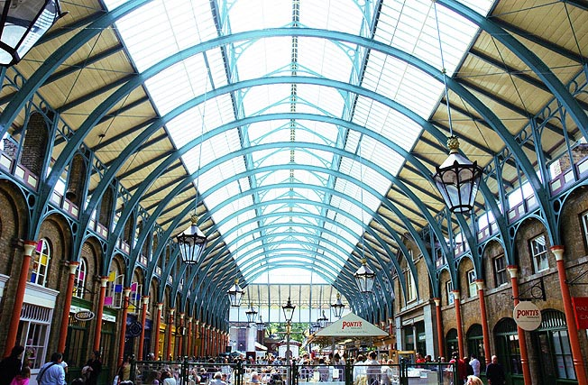
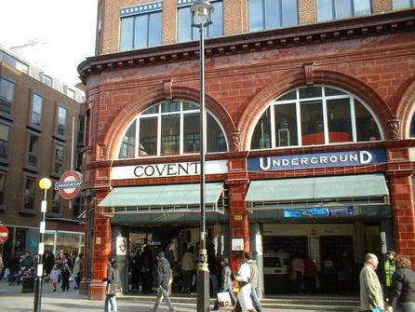
COVENT GARDEN
Home
London

Slide 21
history
Roman times to the 1500s A settlement has existed in the area since the Roman times of Londinium. "Convent Garden" (later corrupted to Covent Garden as we know it today) was the name given, during the reign of King John (1199 - 1256), to a 40 acre (160,000 m²) patch in the county of Middlesex. 1600s to 1800s The modern-day Covent Garden has its roots in the early seventeenth century when land ("the Convent's Garden") was redeveloped by Francis Russell, 4th Earl of Bedford. The area was designed by Inigo Jones, the first and greatest of English Renaissance architects. He was inspired by late 15th Century and early 16th century planned market towns known as bastides (themselves modelled on Roman colonial towns by way of nearby monasteries, of which "Convent" Garden was one). The area rapidly became a base for market traders, and following the Great Fire of London of 1666 which destroyed 'rival' markets towards the east of the city, the market became the most important in the country. Exotic items from around the world were carried on boats up the River Thames and sold on from Covent Garden built to provide a more permanent trading centre. Modern day period By the end of the 1960s, traffic congestion in the surrounding area had reached such a level that the use of the square as a market, which required increasingly large lorries for deliveries and distribution, was becoming unsustainable. The whole area was threatened with complete redevelopment. Following a public outcry, in 1973 the Home Secretary, Robert Carr, gave dozens of buildings around the square listed building status, preventing redevelopment. The following year the market finally moved to a new site (called the New Covent Garden Market) about three miles south-west at Nine Elms. The square languished until its central building re-opened as a shopping centre and tourist attraction in 1980. Since 2005, Covent Garden has been home to the Avenue of Stars, London's answer to Hollywood's Walk of Fame, which runs in front of St Paul's Church, also known as the "Actors' Church".

Slide 22
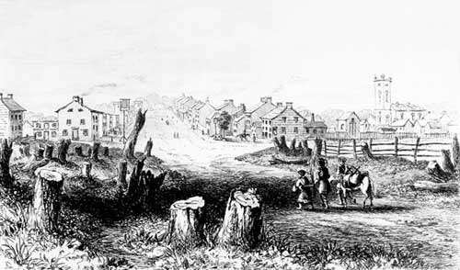
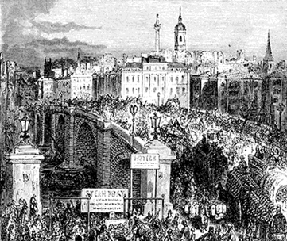
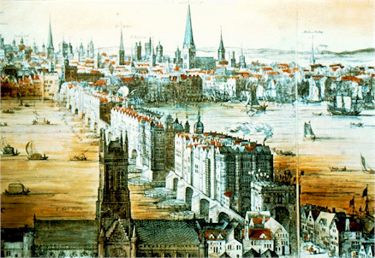
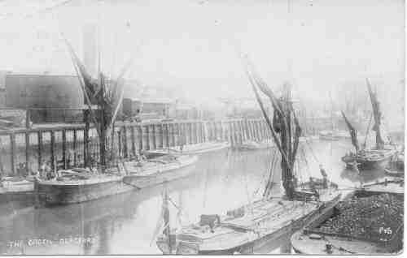
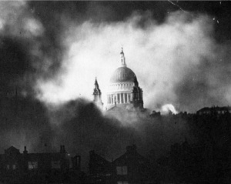
Old London

Slide 23
Trafalgar Square is a square in central London that commemorates the Battle of Trafalgar (1805), a British naval victory of the Napoleonic Wars. The original name was to have been "King William the Fourth's Square", but George Ledwell Taylor suggested the name "Trafalgar Square".
The area had been the site of the King's Mews since the time of Edward I. In the 1820s the Prince Regent engaged the landscape architect John Nash to redevelop the area. Nash cleared the square as part of his Charing Cross Improvement Scheme. The present architecture of the square is due to Sir Charles Barry and was completed in 1845.
The square is a popular site for political demonstrations, is the site of Nelson's Column, and related sculptures of note.
The square consists of a large central area surrounded by roadways on three sides, and stairs leading to the National Gallery on the other. The roads which cross the square form part of the busy A4 road, and prior to 2003, the square was surrounded by a one-way traffic system on all sides. Underpasses attached to Charing Cross tube station still allow pedestrians to avoid traffic. Recent works have reduced the width of the roads and closed the northern side of the square to traffic.
Nelson's Column is in the centre of the square, surrounded by fountains designed by Lutyens in 1939 and four huge bronze lions sculpted by Sir Edwin Landseer; the metal used is said to have been recycled from the cannon of the French fleet. The column is topped by a statue of Lord Nelson, the admiral who commanded the British Fleet at Trafalgar.
On the north side of the square is the National Gallery and to its east the St Martin's-in-the-Fields church. The square adjoins The Mall via Admiralty Arch to the southwest. To the south is Whitehall, to the east Strand and South Africa House, to the north Charing Cross Road and on the west side is Canada House.
At the corners of the square are four plinths; the two northern ones were intended to be used for equestrian statues, and thus are wider than the two southern. Three of them hold statues: George IV (northeast, 1840s), Henry Havelock (southeast, 1861, by William Behnes), and Sir Charles James Napier (southwest, 1855). Mayor of London Ken Livingstone controversially expressed a desire to see the two generals replaced with statues that "ordinary Londoners would know".
Trafalgar Square

Slide 24
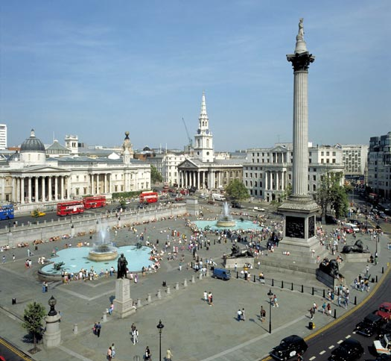
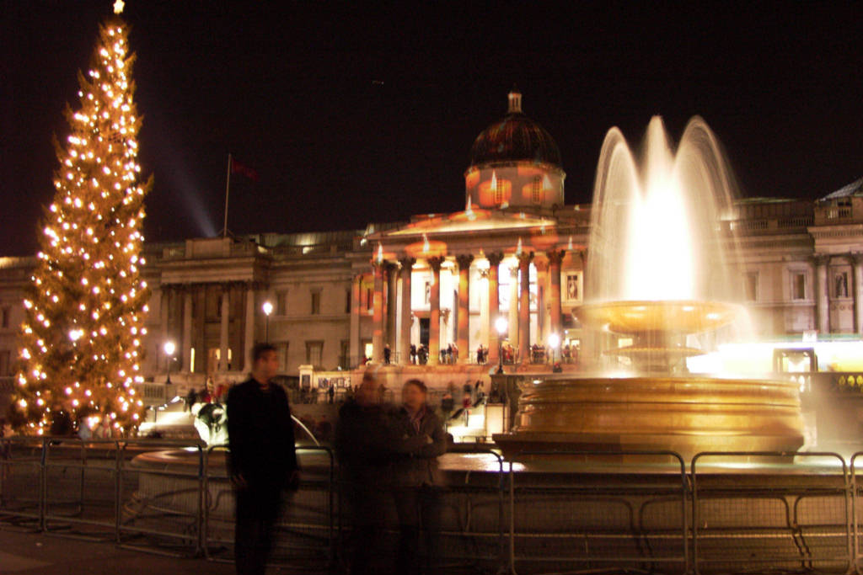
Trafalgar Square

Slide 25
Piccadilly takes it name from a 17th century frilly collar called a picadil.
A dressmaker grew rich making them and built a house in the vicinity.
For many years, Piccadilly Circus - at the junction of five busy streets - has been a famous London Landmark.
At its heart and backlit by colorful electric displays is a bronze fountain topped by a figure of a winged archer. The statue is popularly called EROS, the pagan god of love, but it was in fact designed in the 19th century as a symbol of Christian charity - a monument to Lord Shaftesbury, a philanthropist.
Piccadilly Circus
The famous statue of Eros in Piccadilly Circus is one of the symbols of London. It was originally called the Shaftesbury Monument, having been erected as a memorial to the philanthropist Lord Shaftesbury. The actual figure rises above a fountain, which is made in bronze, but Eros is made out of aluminum, at that time a rare and novel material.

Slide 26
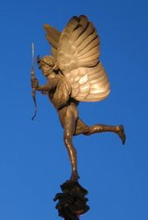
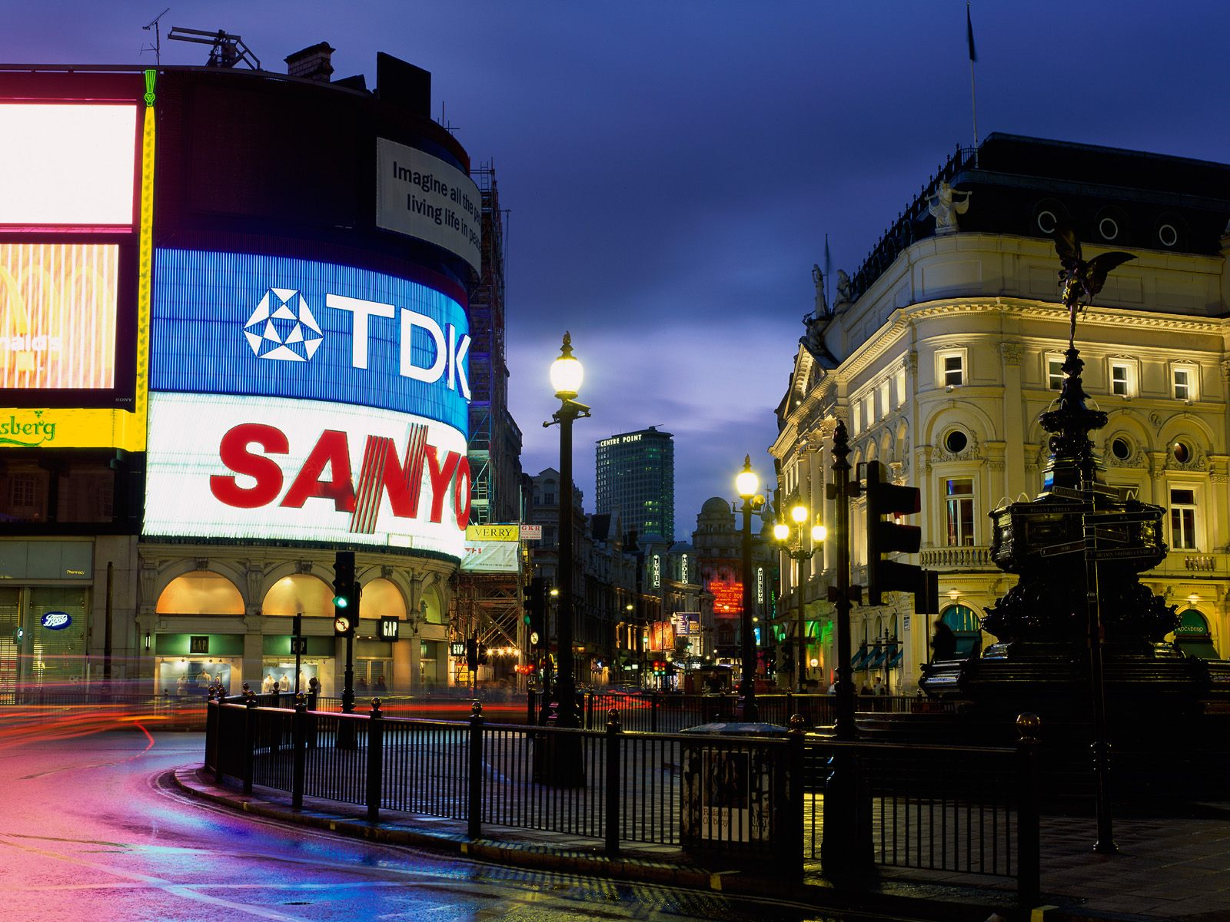

Slide 27
Leicester Square
Leicester Square (pronounced "Lester Square") is a pedestrianised square in the West End of London, United Kingdom. The Square lies within an area bound by Lisle Street, to the north; Charing Cross Road, to the east; Orange Street, to the south; and Whitcomb Street, to the west. The park at the centre of the Square is bound by Cranbourn Street, to the north; Leicester Street, to the east; Irving Street, to the south; and a section of road designated simply as Leicester Square, to the west. It is within the City of
Westminster, and about equal distances (about 0.2 miles or 300 meters) north of Trafalgar Square, east of Piccadilly Circus, west of Covent Garden, and south of Cambridge Circus.

Slide 28
Leicester Square in 1750, looking north. The large house set behind a forecourt at the northeast corner is Leicester House, then the residence of Frederick, Prince of Wales. The Square is named for Robert Sidney, 2nd Earl of Leicester, who purchased four acres (1.6 hectares) of land in St. Martin's Field in 1630; by 1635, he had built himself a large house, known as Leicester House, at the northern end of it. The enclosure of part of the site for building deprived the inhabitants of St. Martin's Parish of their right to use the common land. King Charles I appointed three members of the Privy Council to arbitrate, and Lord Leicester was ordered to keep part of his land (which thereafter was known as Leicester Field and later as Leicester Square) open for use by the parishioners.
The area was developed in the 1670s. It was initially a fashionable area, and Leicester House was once even the residence of Frederick, Prince of Wales;
but, by the later part of the 18th century, the Square was no longer a smart address
Leicester House was demolished about 1791–1792, Leicester Square was the subject of the famous land-law case of Tulk vs. Moxhay

Slide 29
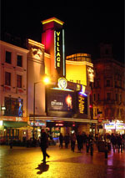
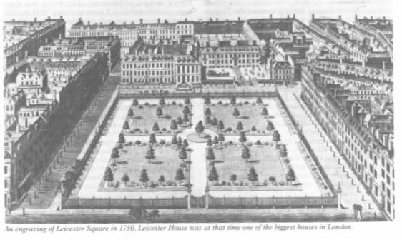
The plot's previous owner had agreed upon a covenant not to erect buildings after his purchase. However, the law would not allow purchasers who were not 'privy' to the initial contract to be bound by any subsequent promises. The leading judge, Lord Cottenham, decided that future owners of land could be bound by promises to abstain from activity. Otherwise, a buyer could simply sell land to himself again to undermine an initial promise.
Hence, the Leicester Square known today was saved from development.
By the 19th century, Leicester Square was known as an entertainment venue, and also housed several hotels. It was popular with overseas residents and visitors to London.
A large theatre, the Alhambra, built in 1854, dominated the site.

Slide 30
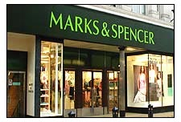
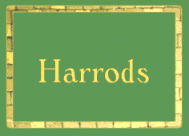

shopping
In British towns and cities there are lots of large department stores and supermarkets and most people do their shopping there.
Quite often shops and other facilities such as banks, post offices, cinemas and restaurants are grouped together in one place where customers can find everything they need. There are a lot of big companies with shopping outlets all over Britain.
BOOTS is the most famous chemist’s, selling medicines and toiletries is a leading company selling books, stationery and greetings cards.
Marks and Spencer is one of the most popular department stores in Britain.
Harrods is one of the largest department stores in the world with its three hundred department on seven floors.
A popular shop with children is Hamley’ one of the biggest toy shops in the world.

Slide 31
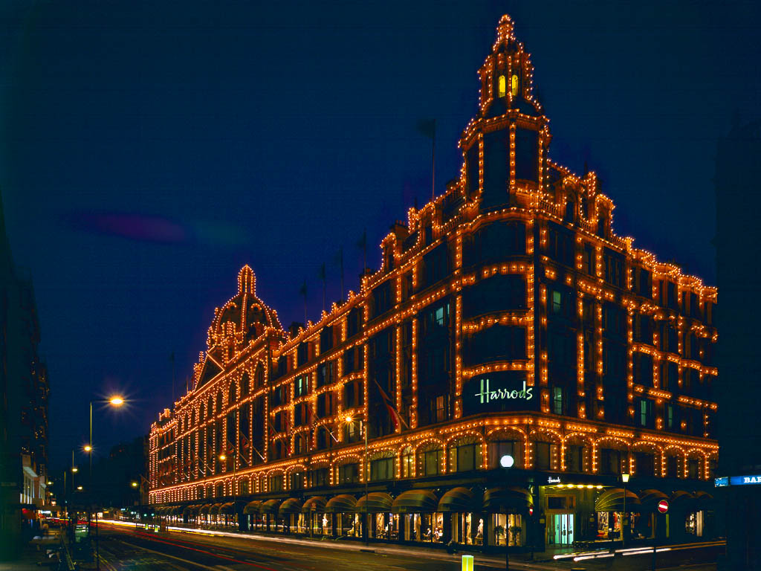

Slide 32
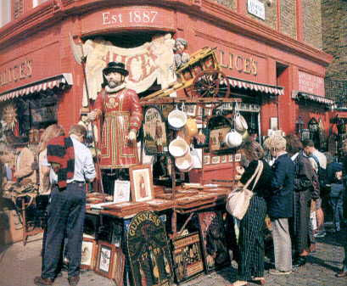
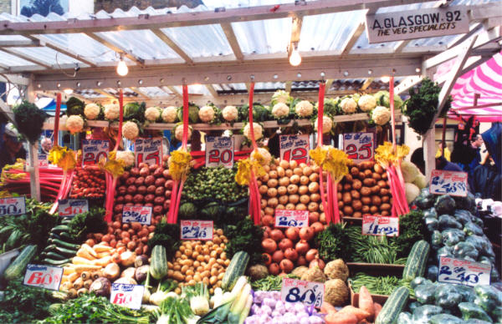
London also offers a lot of outdoor markets. At the Saturday Camden lock you can buy clothes, ethnic jewellery, old records and so on. It is always full of young people and is very trendy. The market in Notting Hill is also very popular. The Sunday market is a bit like an oriental bazaar. The market in Portobello Road is famous for antiques, but it isn’t easy to find a bargain!

